Slide 1

Al-Quran mood detection

Slide 2
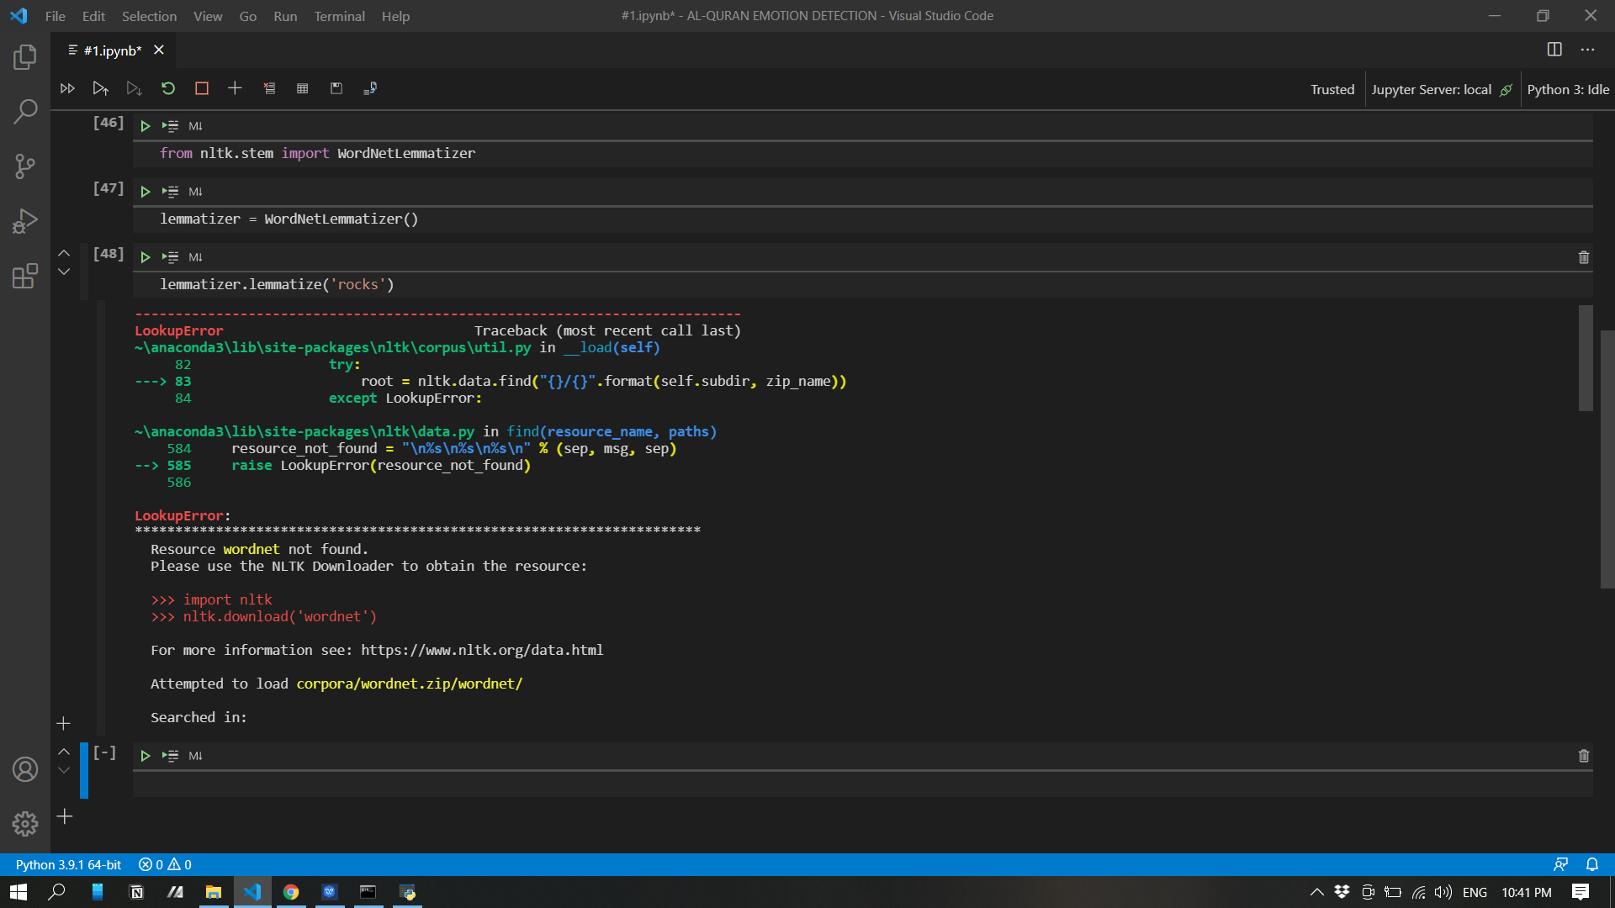
Once, You want to use nltk for nlp just to make sure that you’ve already installed corpus

Slide 3
The Solution...

Slide 4
CORPUS Installation

Slide 5
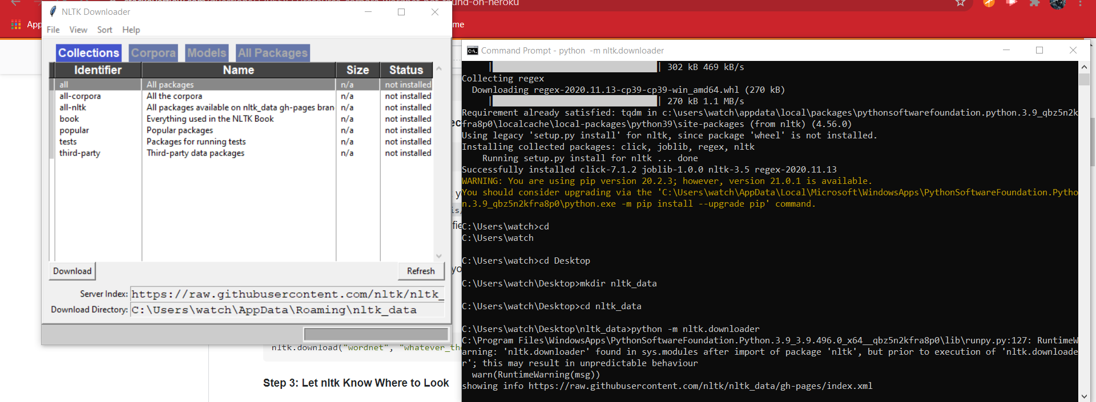
Open CMD

Slide 6
Let’s do some codes
1. Making a Directory -> mkdir nltk_data
2. Locate your files in nltk_data directory -> cd nltk_data
3. intalling the packages -> python -m nltk.downloader

Slide 7
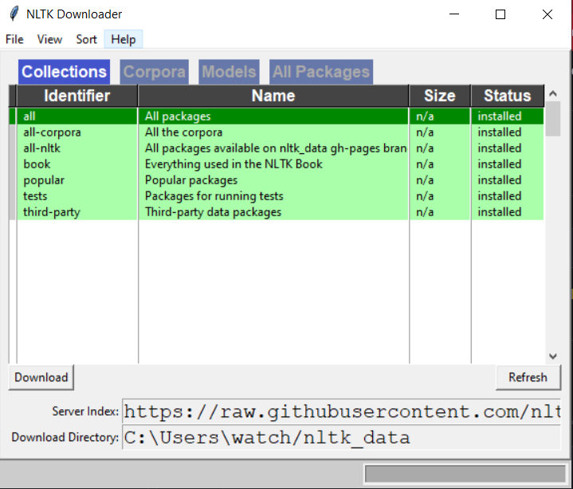
Choose the packages you want....
You can choose the packages you want individualy or install all but forget not to specify the direct in Download Directory
And click the Download button

Slide 8
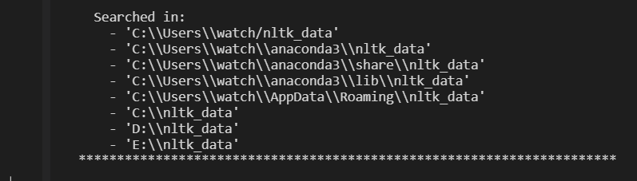
*Just to choose the only one of those directories
Move your files to this directory

Slide 9
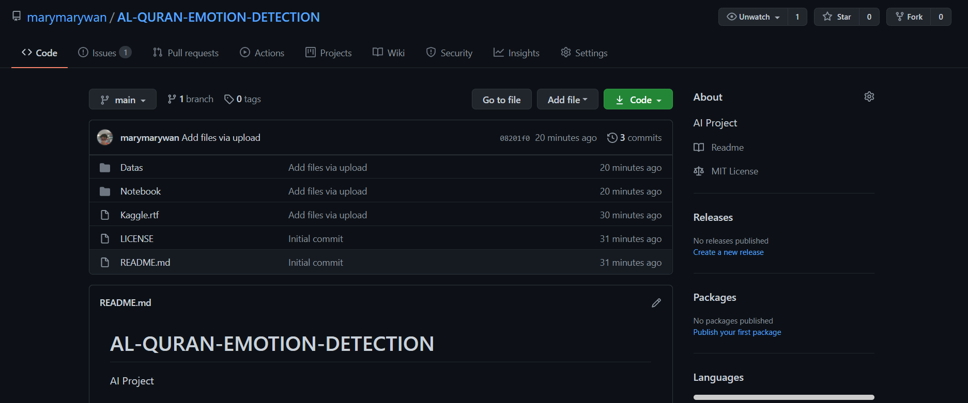
More in Github....

Slide 10
Data Prepocessing with NLTK
#1

Slide 11
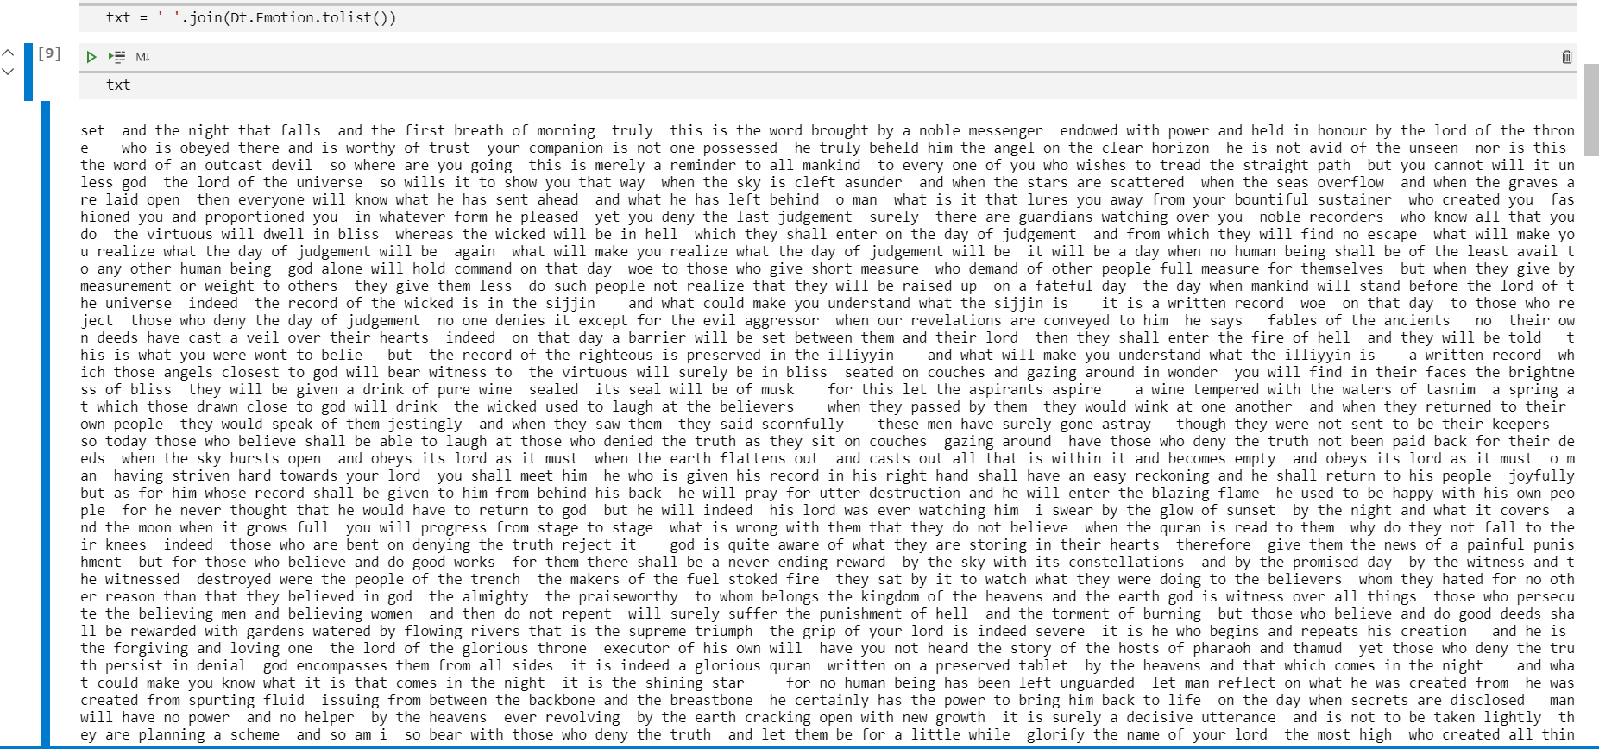
Joining all ayat together by using .join()

Slide 12
The codes
txt = ' '.join(Dt.Emotion.tolist())

